Slide 1

HO CHI MINH CITY UNIVERSITY OF TECHNOLOGY AND EDUCATION
INFORMATION TECHNOLOGY FACULTY
ARTIFICIAL INTELLIGENCE
FINAL SEMESTER REPORT
LECTURER: QUANG TRAN NHAT

Slide 2
MEMBERS
Hoang Ho Huy
Huong Ta Thi Mai
Khanh Lam Quoc
Nam Tran Quoc
Phuc Nguyen Tran
Tien Nguyen Huynh Minh

Slide 3
FOUNDATION PROFILE

Slide 4
PLAGIARISM

Slide 5


WHAT IS PLAGIARISM?

Slide 6




SHOULD/ SHOULDN’T
PREPARE KNOWLEDGE

Slide 7



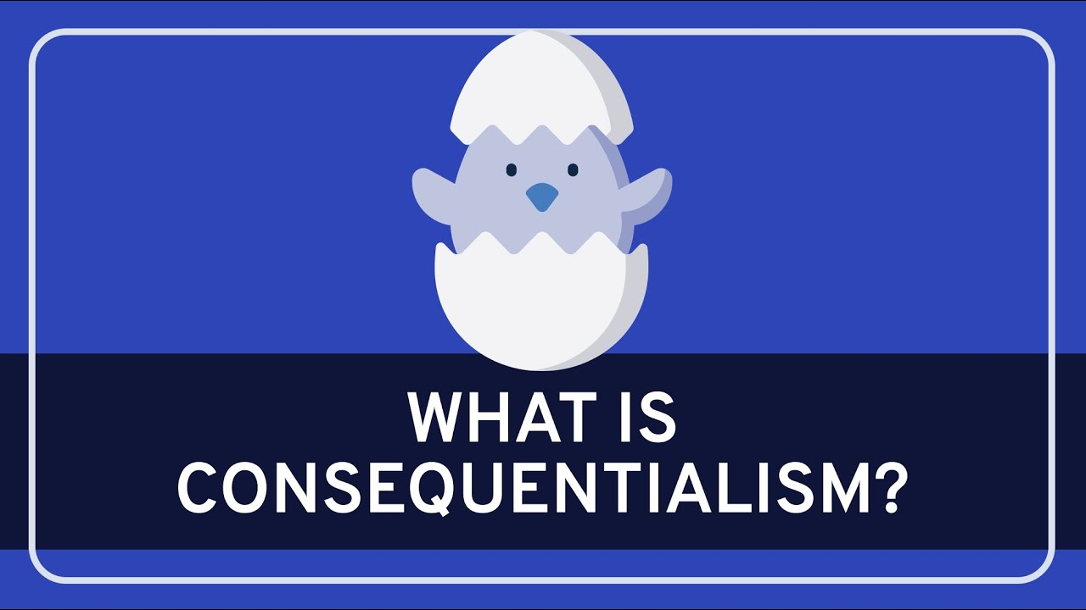
MORALITY

Slide 9
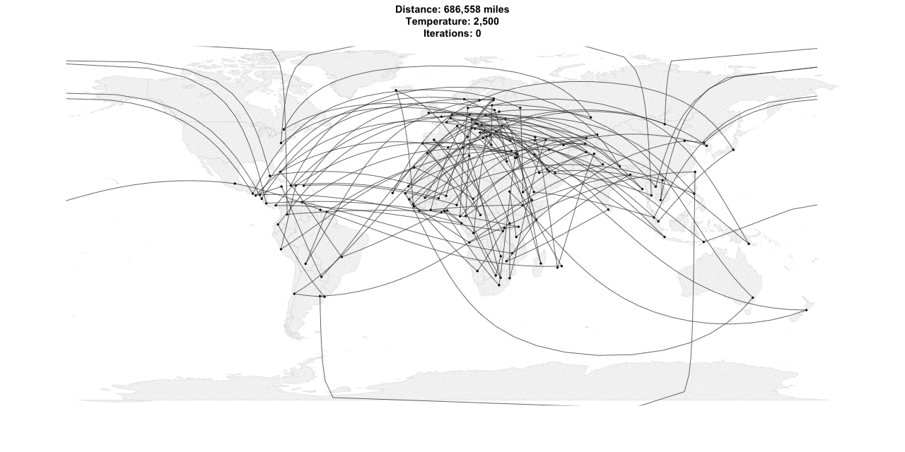
SEARCHING IN MORE COMPLEX ENVIRONMENTS
Notes:
https://toddwschneider.com/posts/traveling-salesman-with-simulated-annealing-r-and-shiny/

Slide 10
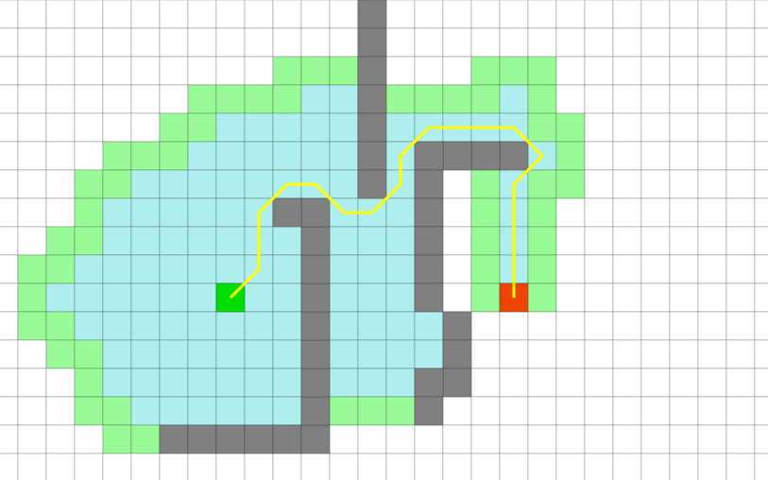
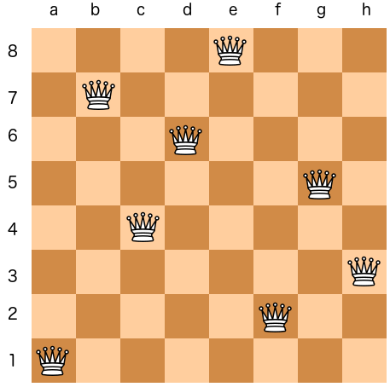
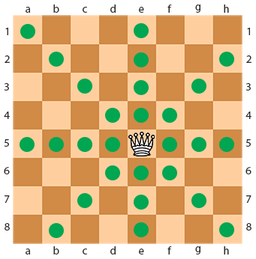
Obversable
Deterministic
Discrete
Notes:
https://www.chessbazaar.com/blog/2019/05/22/chess-pieces-moves-illustrated-guide/ (Obversable)
http://qiao.github.io/PathFinding.js/visual/ (Discrete)

Slide 11
Obversable
Discrete
Deterministic
Notes:
https://www.chessbazaar.com/blog/2019/05/22/chess-pieces-moves-illustrated-guide/ (Obversable)
http://qiao.github.io/PathFinding.js/visual/ (Discrete)

Slide 12

LOCAL SEARCH – SEARCHING FOR GOAL STATE
(BEYOND CLASSICAL SEARCH)
Notes:
Photo by bady qb on Unsplash.

Slide 13
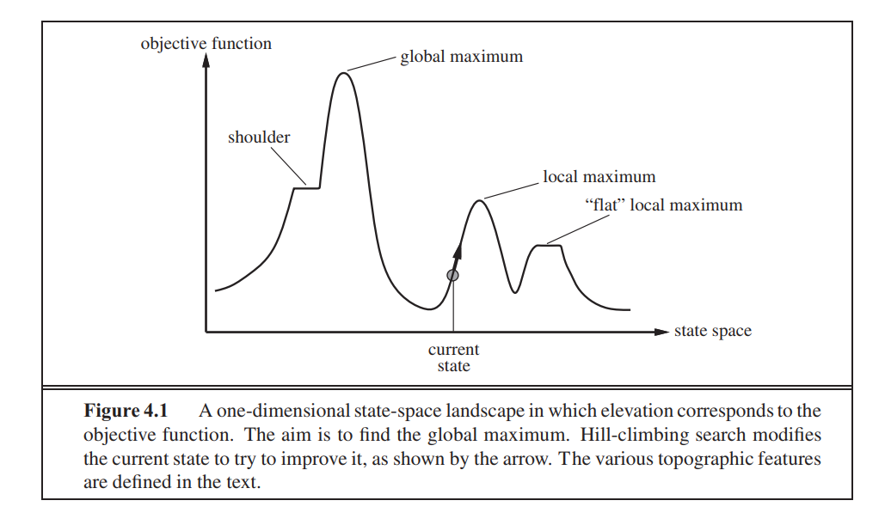
State space landscape

Slide 14
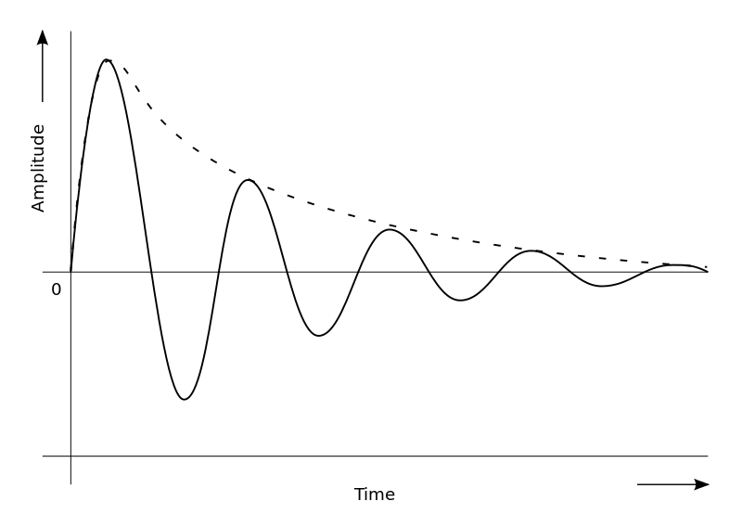



LOCAL SEARCH
Use little memory
Infinite/Continuous state space

Slide 15
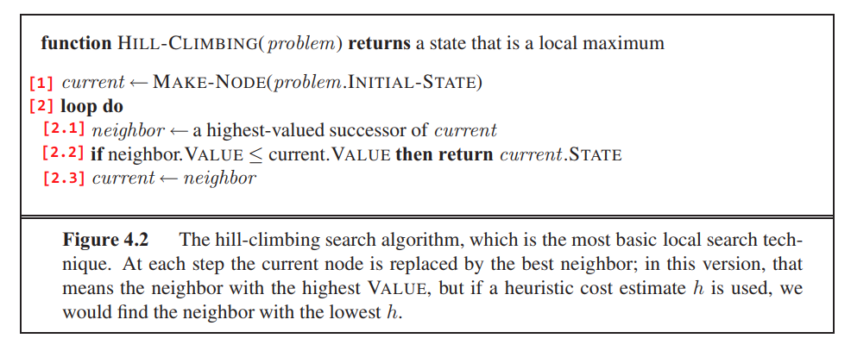
Hill-climbing search

Slide 16
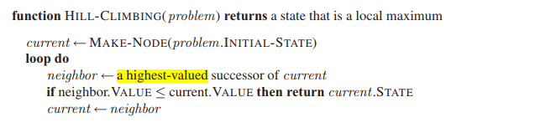

Issues of Hill-climbing search
1
Too many successors
➔ Stochastic hill climbing
This Photo by Unknown Author is licensed under CC BY-SA

Slide 17
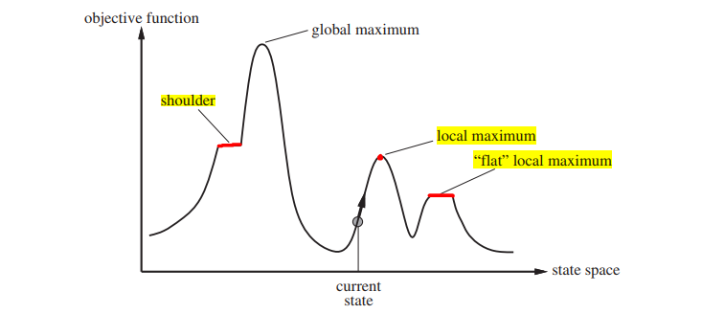
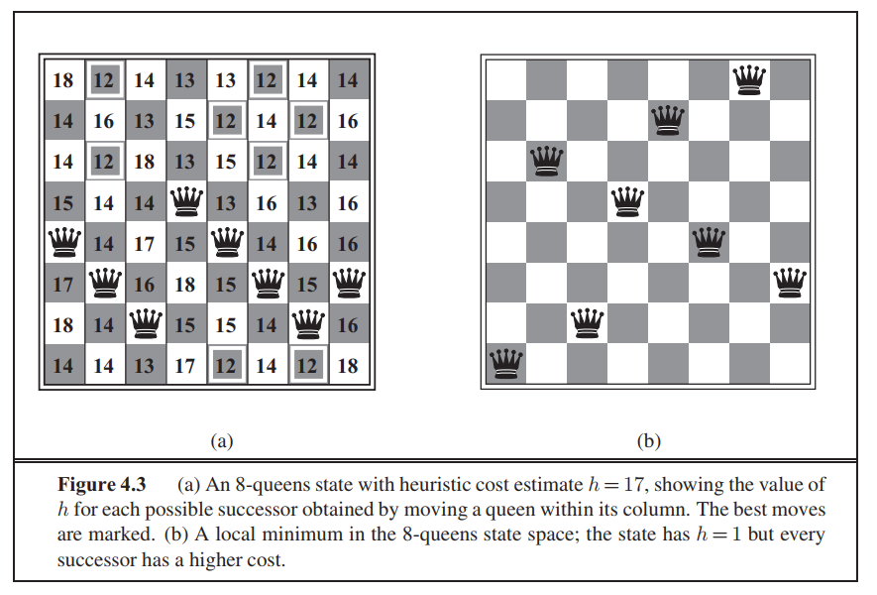
2
Plateaux/Local maxima
Russel, 2016

Slide 18
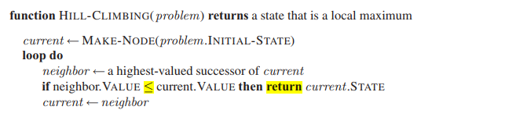
PLATEAUX
Allow sideways moves

Slide 19
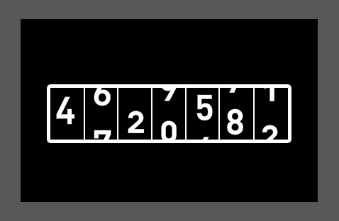
LOCAL OPTIMA
1. Random-restart hill climbing

Slide 20
LOCAL OPTIMA
2.1. Local beam search
2.2. Stochastic beam search

Slide 21

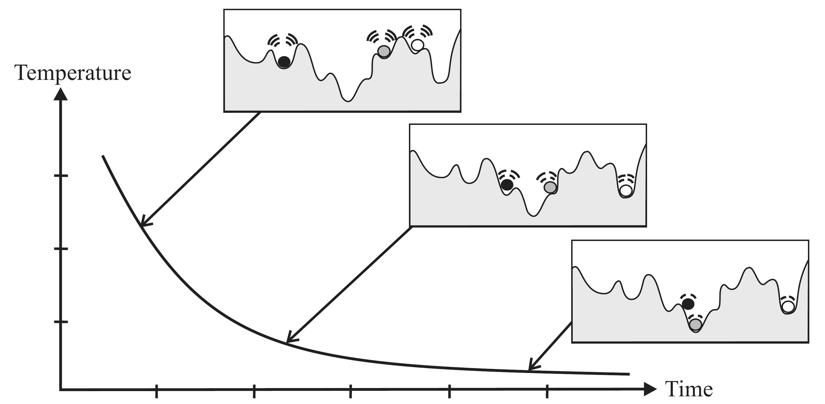
LOCAL OPTIMA
3. Simulated annealing
Notes:
https://www.uef.edu.vn/huong-nghiep/nganh-nghe/nghe-luyen-kim-1390
https://www.intechopen.com/books/simulated-annealing-advances-applications-and-hybridizations/simulated-annealing-evolution

Slide 22
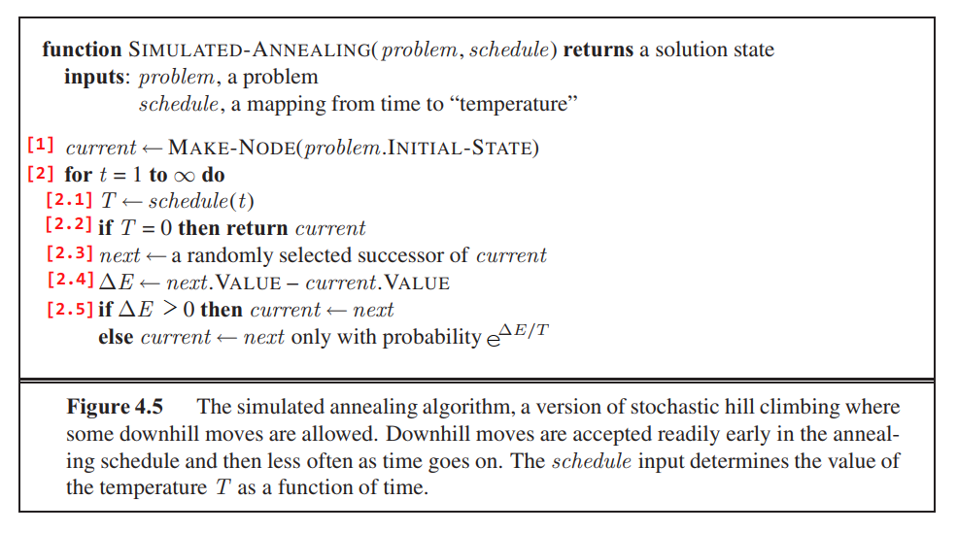
Simulated Annealing

Slide 23
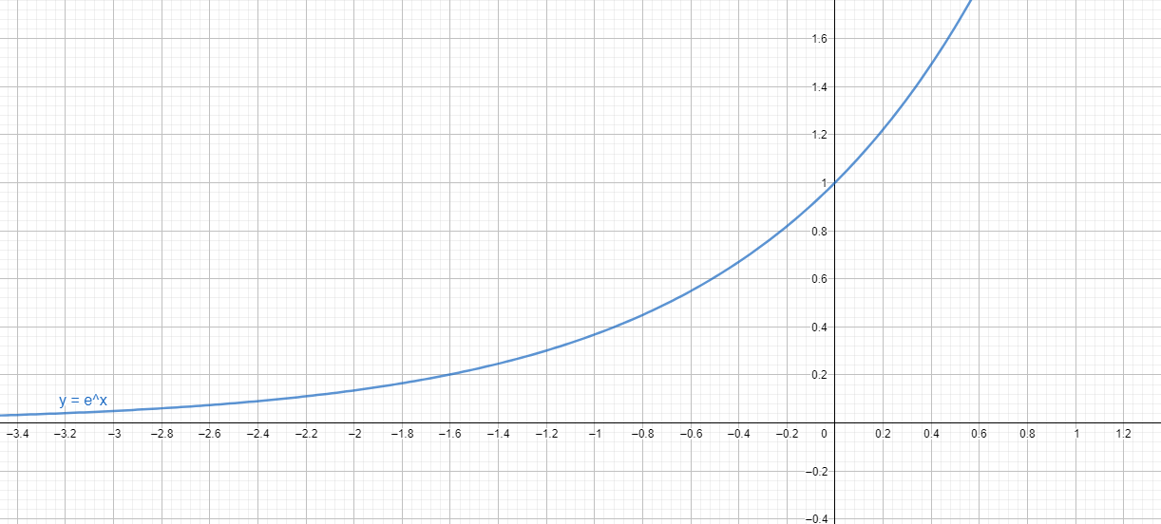
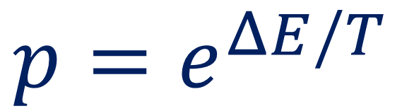
Acceptance probabilities
$$p=e^{ΔE/T}$$

Slide 24
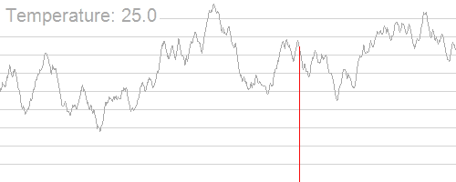
Simulated Annealing
Kingpin13, https://commons.wikimedia.org/wiki/File:Hill_Climbing_with_Simulated_Annealing.gif

Slide 25
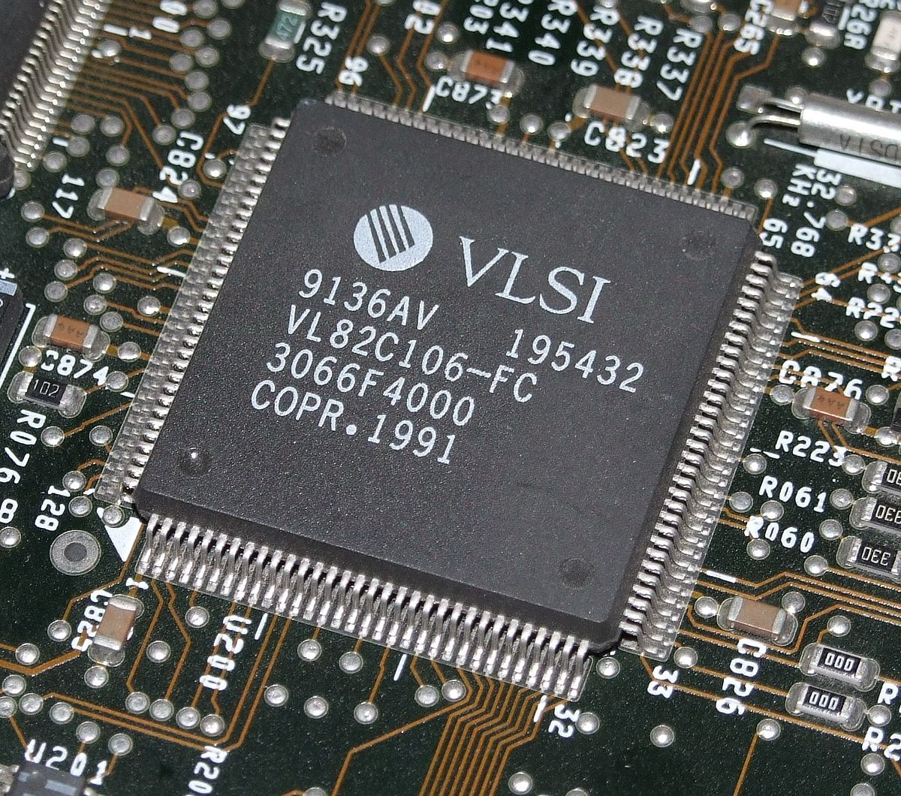
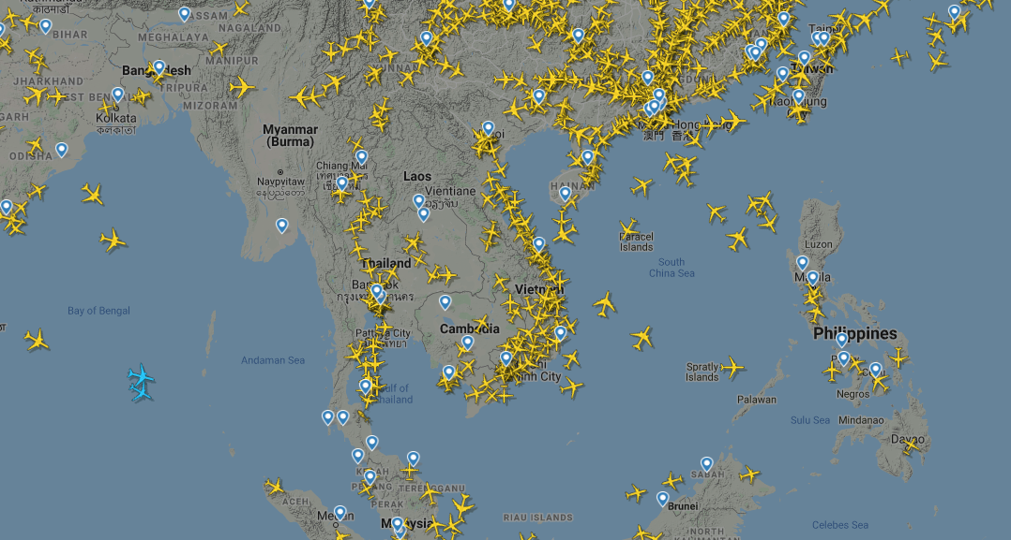
Simulated Annealing
https://www.flightradar24.com/
This Photo by Unknown Author is licensed under CC BY-SA
→ VLSI problem
→ A large-scale aircraft trajectory planning problem
Notes:
Delahaye D., Chaimatanan S., Mongeau M. (2019) Simulated Annealing: From Basics to Applications. In: Gendreau M., Potvin JY. (eds) Handbook of Metaheuristics. International Series in Operations Research & Management Science, vol 272. Springer, Cham
https://link.springer.com/chapter/10.1007/978-3-319-91086-4_1

Slide 26
Simulated Annealing
https://www.flightradar24.com/
This Photo by Unknown Author is licensed under CC BY-SA
→ VLSI problem
→ A large-scale aircraft trajectory planning problem
Notes:
Delahaye D., Chaimatanan S., Mongeau M. (2019) Simulated Annealing: From Basics to Applications. In: Gendreau M., Potvin JY. (eds) Handbook of Metaheuristics. International Series in Operations Research & Management Science, vol 272. Springer, Cham
https://link.springer.com/chapter/10.1007/978-3-319-91086-4_1

Slide 27

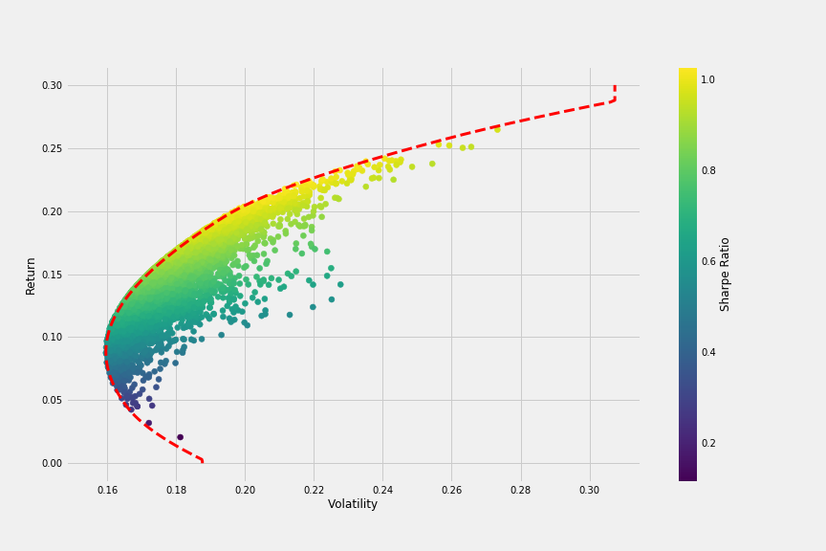
Simulated Annealing
→ Simulated Annealing Evolution
in Artificial Neural Network
Fábio Neves, Plotting Markowitz Efficient Frontier with Python
→ Portfolio Optimization
Notes:
https://www.researchgate.net/figure/Artificial-neural-network-architecture-ANN-i-h-1-h-2-h-n-o_fig1_321259051

Slide 28
Simulated Annealing
Fábio Neves, Plotting Markowitz Efficient Frontier with Python
→ Simulated Annealing Evolution
in Artificial Neural Network
→ Portfolio Optimization
Notes:
https://www.researchgate.net/figure/Artificial-neural-network-architecture-ANN-i-h-1-h-2-h-n-o_fig1_321259051

Slide 30
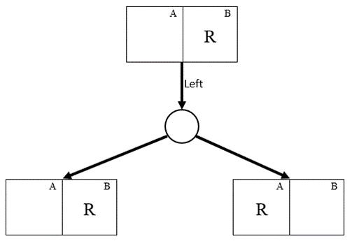
Searching in Nondeterministic environments
Results (State, action) → States{s1, s2, s3,…}
EX: Results (B, Left) → States {s1 = B, s2 = A}

Slide 31
A
A
1
1
…
B
…
B
C
IDEA
C
And-Or Graph Search
2
2
3
3
4
G
D
G
G
G
G
G
G

Slide 32
A
A
A
1
1
1
…
B
…
B
B
C
C
IDEA
C
2
2
2
3
3
3
4
G
D
G
G
G
G
G
G
G
G
G

Slide 33
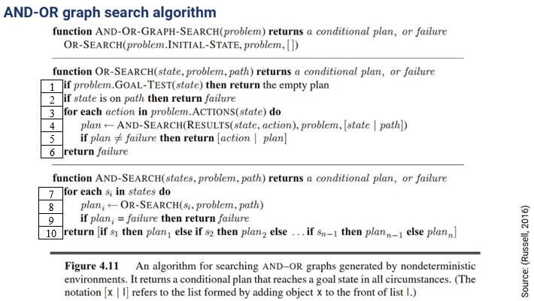
Algorithm

Slide 34
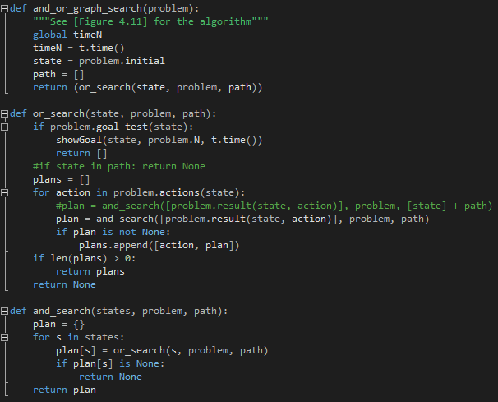
Code

Slide 35
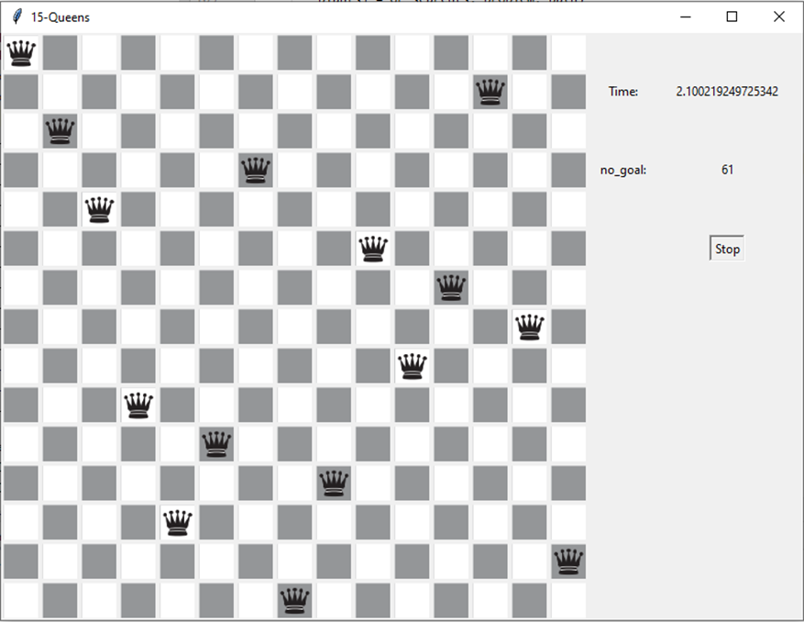
Interface

Slide 36
IDEA
ACTIONS(belief state b) → b = {s1, s2}
actionsp(s1) = {a, b, c}
actionsp(s2) = {a, c, d}
có thể chọn actions(b) = {a, b, c, d}
hoặc = {a, b}
RESULT (belief state b, action a) = new belief state b’
b = {s1, s2}
b’ = Resultp (s1, a) → Resultp (s2, a)
SEARCHING IN
PARTIALLY OBSERVABLE ENVIROMENTS

Slide 37
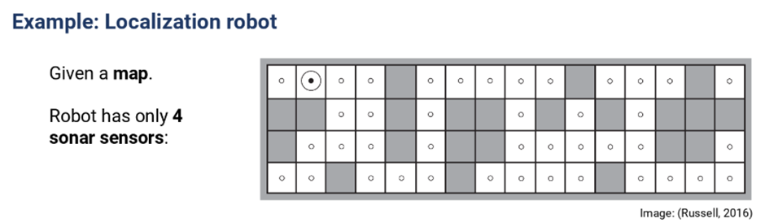
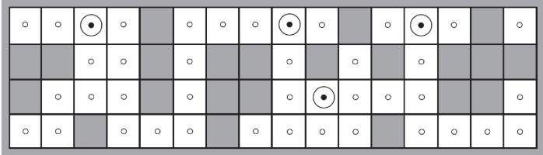
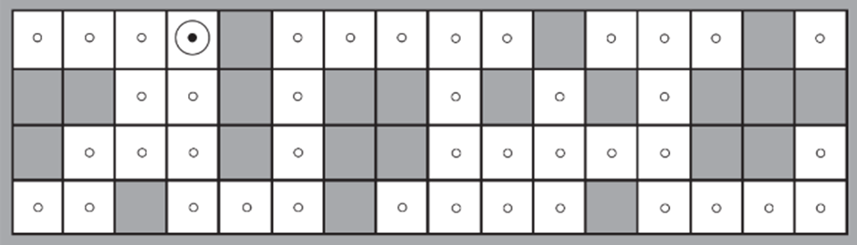

Slide 39
ONLINE SEARCH AND OFFLINE SEARCH

Slide 40

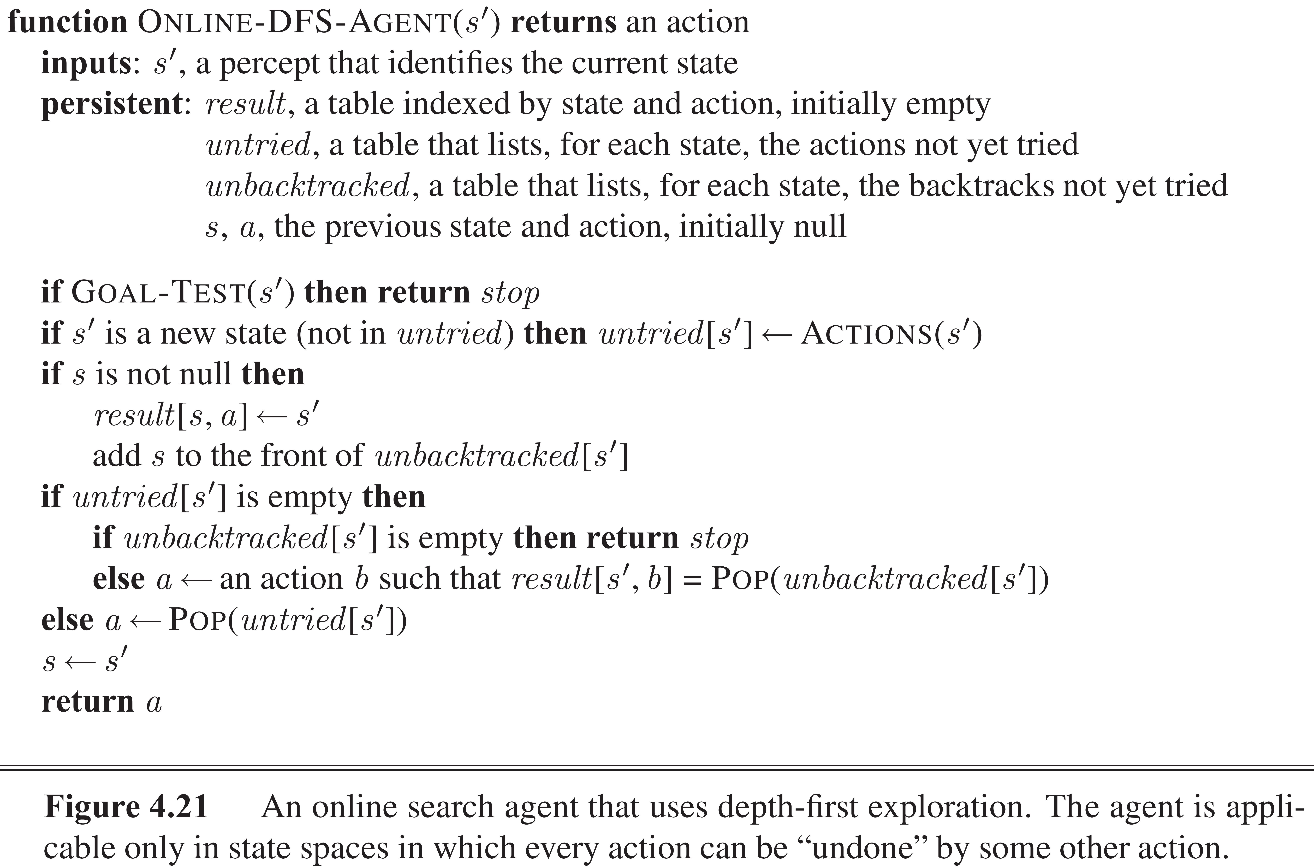
COMPARISON

Slide 41
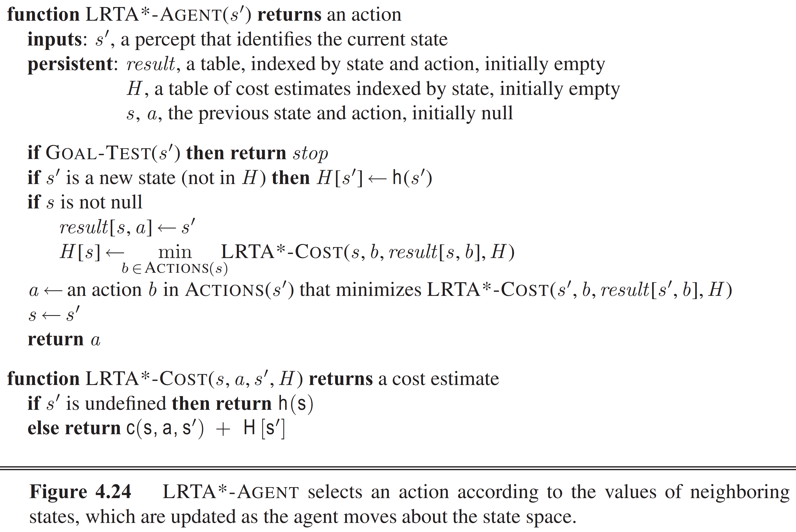
ONLINE A* SEARCH

Slide 42
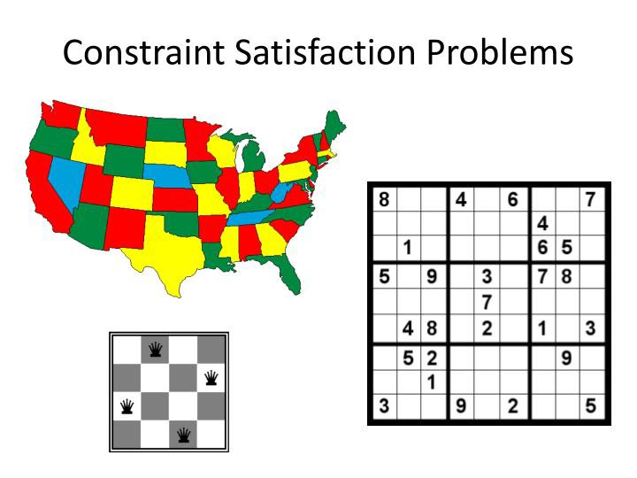
CONSTRAINT SATISFACTION PROBLEMS
(CSP)

Slide 43
CSP has 3 components
X
Set of all variables
D
Set of values that variables are allowed to receive
C
Set of constraints that variables must satisfy
CSP’s Solution

Slide 44
Constraint propagation
Ideas
Specifically

Slide 45
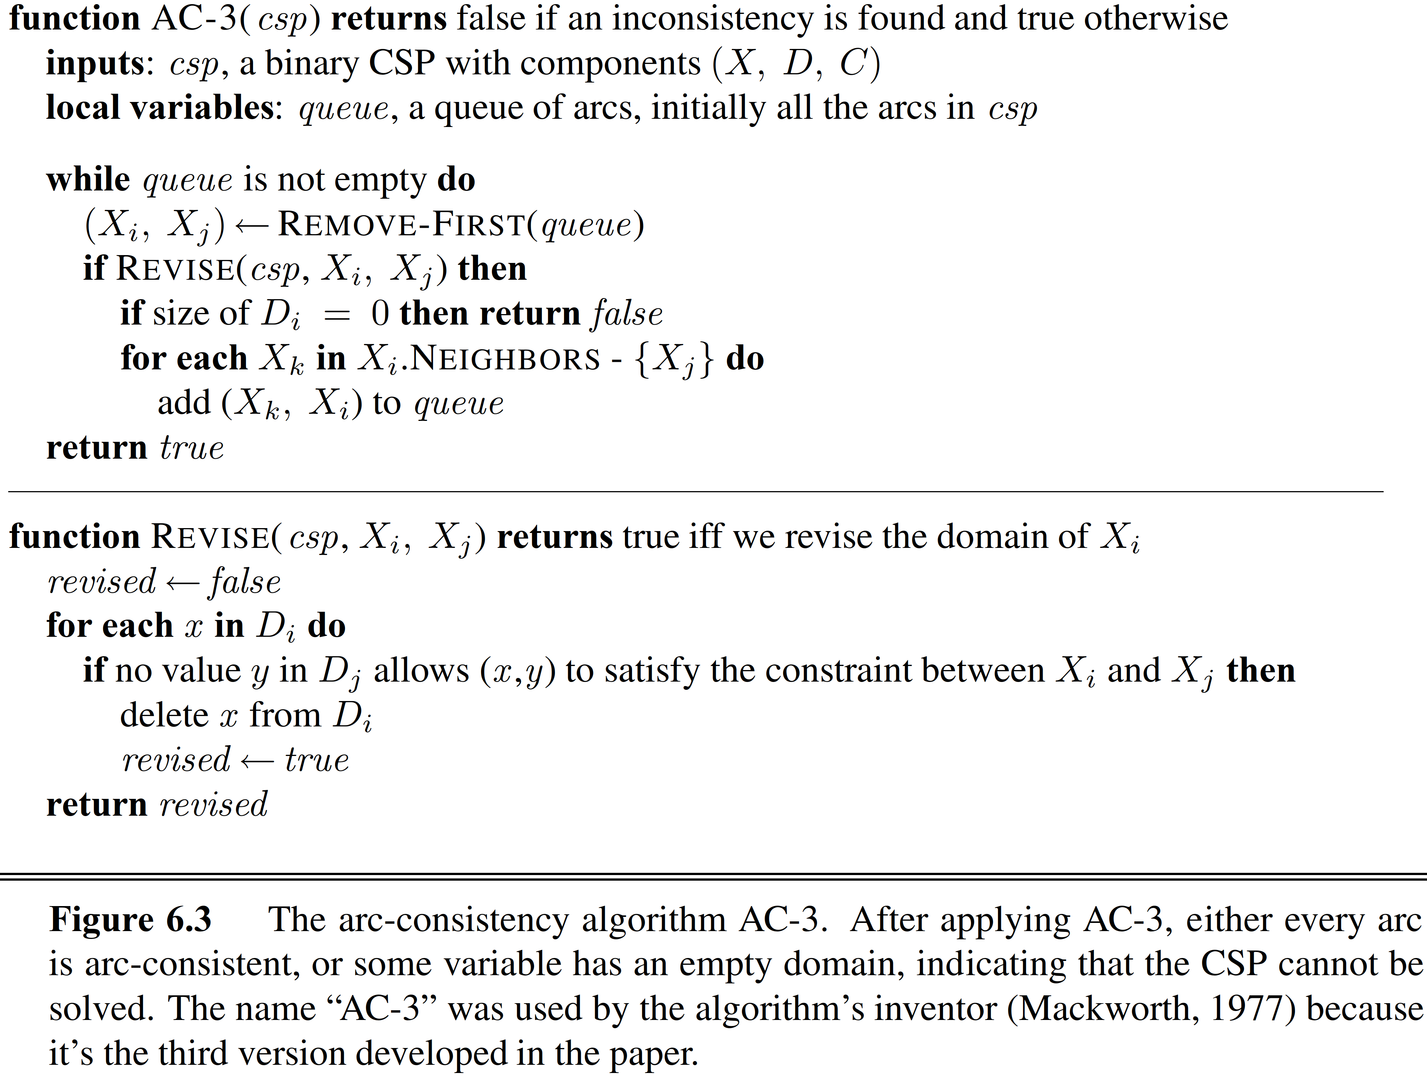
AC – 3 algorithm (arc consistency)
Local consistency (node , arc , path)

Slide 46
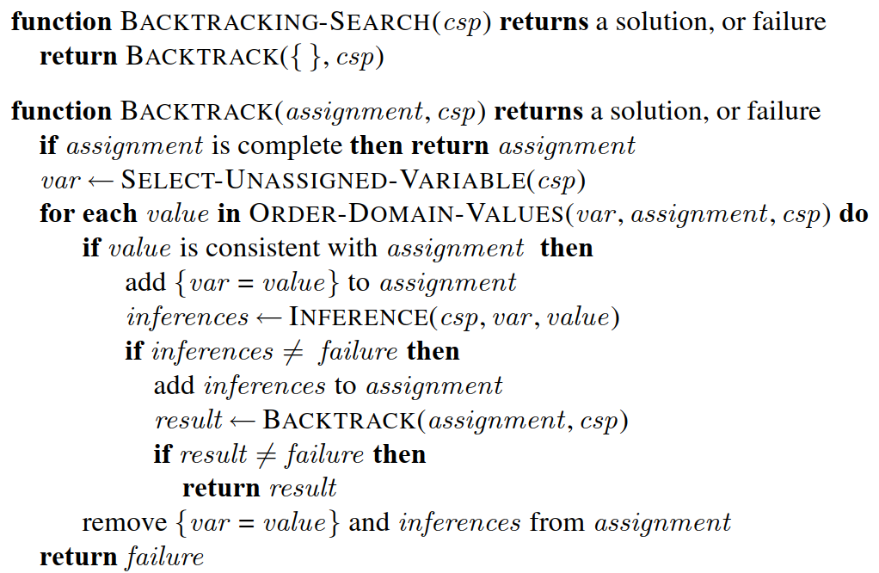
CONSISTENCY
Path consistency
K consistency
GLOBAL CONSTRAINTS

Slide 47
Comments on backtracking search algorithm
Select next variable and values
Inference
Backtracking strategies

